Slide 1
Coursera capstone project Applied Data Science Capstone
Opening gym in Vilnius

Slide 2
Introduction
Vilnius is the capital and the largest city of Lithuania. The city itself has a population of ~550 000 people. Vilnius consist of 21 elderships, a statewide administrative division, which are based on neighborhoods. Many people around the world are facing serious health issues associated with unhealthy eating habits and a lack of exercise. With growing health concerns, more people are joining gyms for exercise and the motivation to change their eating habits. Lately Vilnius has beed growing very fast resulting in growing demand of gyms.

Slide 3
Business Problem
Questions that will be answered in this project:
1. Is there any location without gym?
2. Which areas have large number of gyms?
3. Which areas have least number of gyms?
4. What are areas with least competition? (at least one gym in that area)

Slide 4
Required data
To solve the problem, we will need the following data:
1. Vilnius city data contain neighborhoods.
2. Coordinates of those neighborhoods.
3. Venue data, particular data related to fitness industry.

Slide 5
Methodology
In first step we will collect the required data: location and type (category) of every gym in each neighborhood.
Second step in our analysis will be calculation and exploration of number of gyms across different neighborhoods.
In third and final step we will focus clusters of locations. We want locations where numbers of gyms is least. We will present map of all clusters and identify most promising neighborhoods.

Slide 6
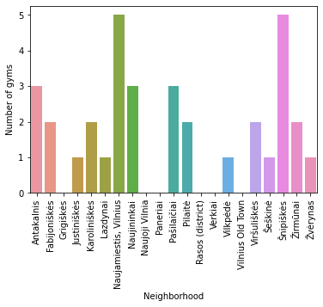
Analysis (1)
Number of gyms were counted in every area.

Slide 7
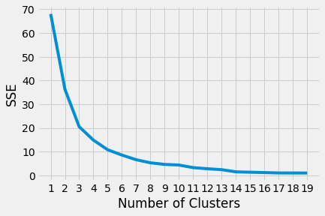
Analysis (2)
Elbow method to determine number of clusters.

Slide 8
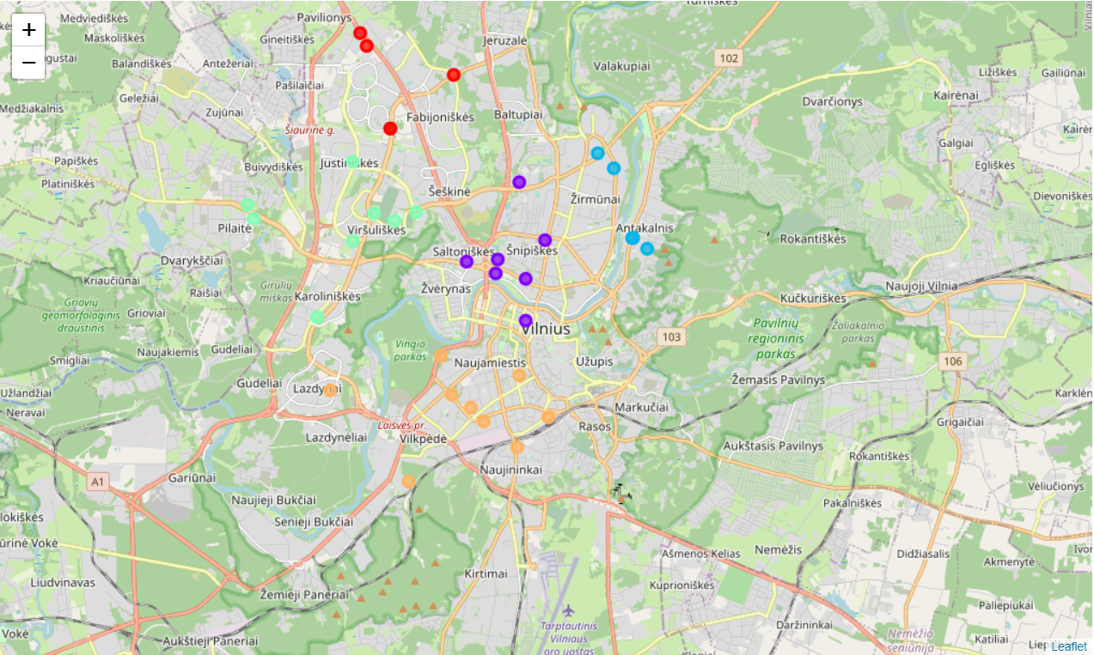
Analysis (3)

Slide 9
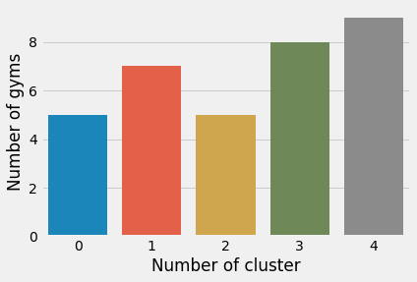
Analysis (4)

Slide 10
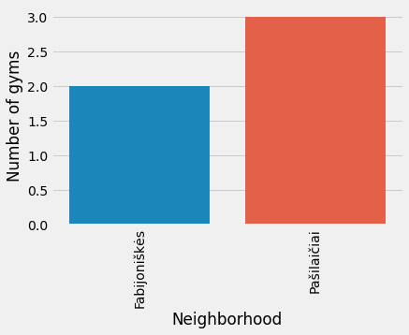
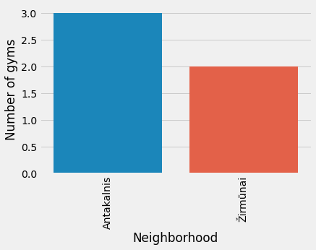
Analysis (5)

Slide 11
Results and Discussion
Our analysis shows that there is 34 gyms in Vilnius. Some areas don't have any gyms. Those areas might be interesting to open new gym, but there is always a possibility, that area due at the moment unnown reason is not suitable for fitness industy. That why for further analysis we looked at areas where already is competition. Areas with highest and least compeatition were found. In least competition areas we have found two neigbohoods which might be suitable for opening new gym.

Slide 12
Conclusion
There is 5 neighborhoods without any gym.
There are two area with most gyms.
There are 5 areas with least number (one) of gyms.
Areas with least competition: Fabijoniskes and Zirmunai

